Slide 1
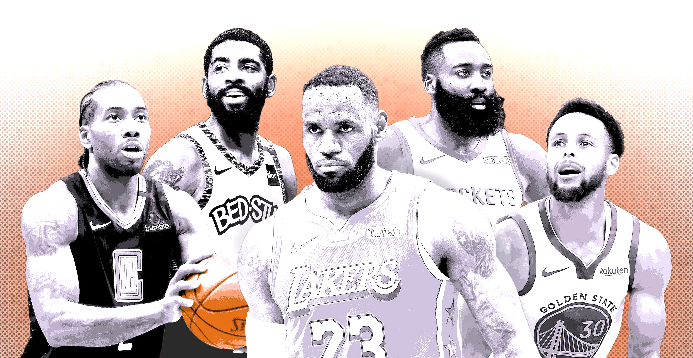

Data Science- Final Project NBA
May Natan & Amitay Biton
GITHUB //add link

Slide 2

NBA – The National Basketball Association
A professional basketball league in North America. The league is composed of 30 teams (29 in the United States and 1 in Canada) and is one of the four major professional sports leagues in the United States and Canada. It is the premier men's professional basketball league in the world.

Slide 3


Research questions
Can we predict who will be the winner in each game?

Slide 4
Main Steps
Collecting Data
from API or Web Crawling
Scrubbing Data
cleaning and formatting the data
Visualizing Data
Modeling Data
Presenting the data
delivering the result and final predict model

Slide 5

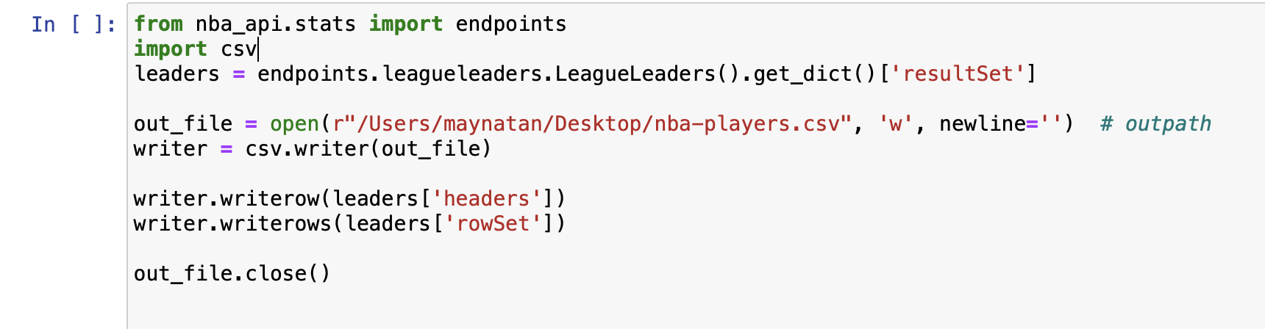
Data sources
Data:
Games Score – seasons 2020-2021
Players Score
API – NBA: https://www.nba.com/stats/

Slide 6
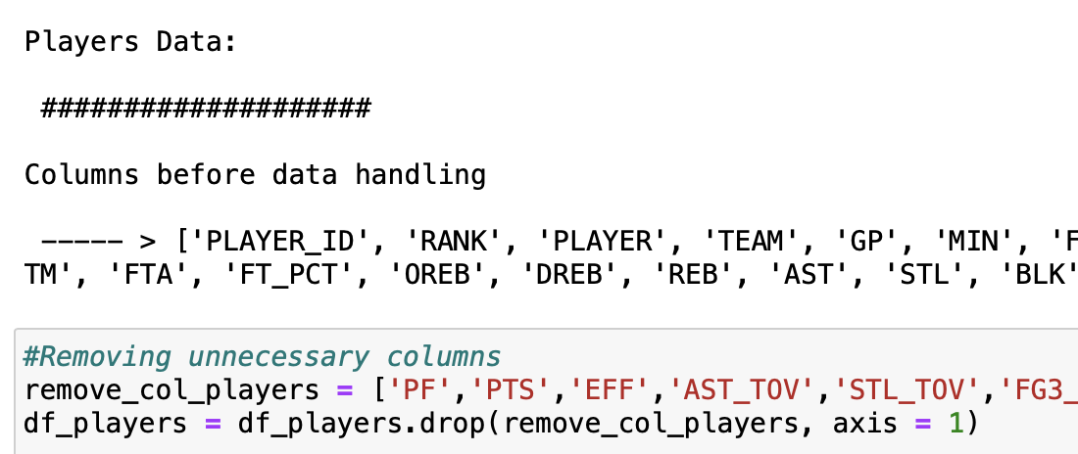
Data Cleaning
Missing values:
Dropping columns with too many ‘0’ values
Cleaning:
Removing unnecessary information
Table:
Creating 2 more tables with the main information we need for the machine learning step.
New calculation:
Calculate score for each team and player and add the information to the data frame

Slide 7
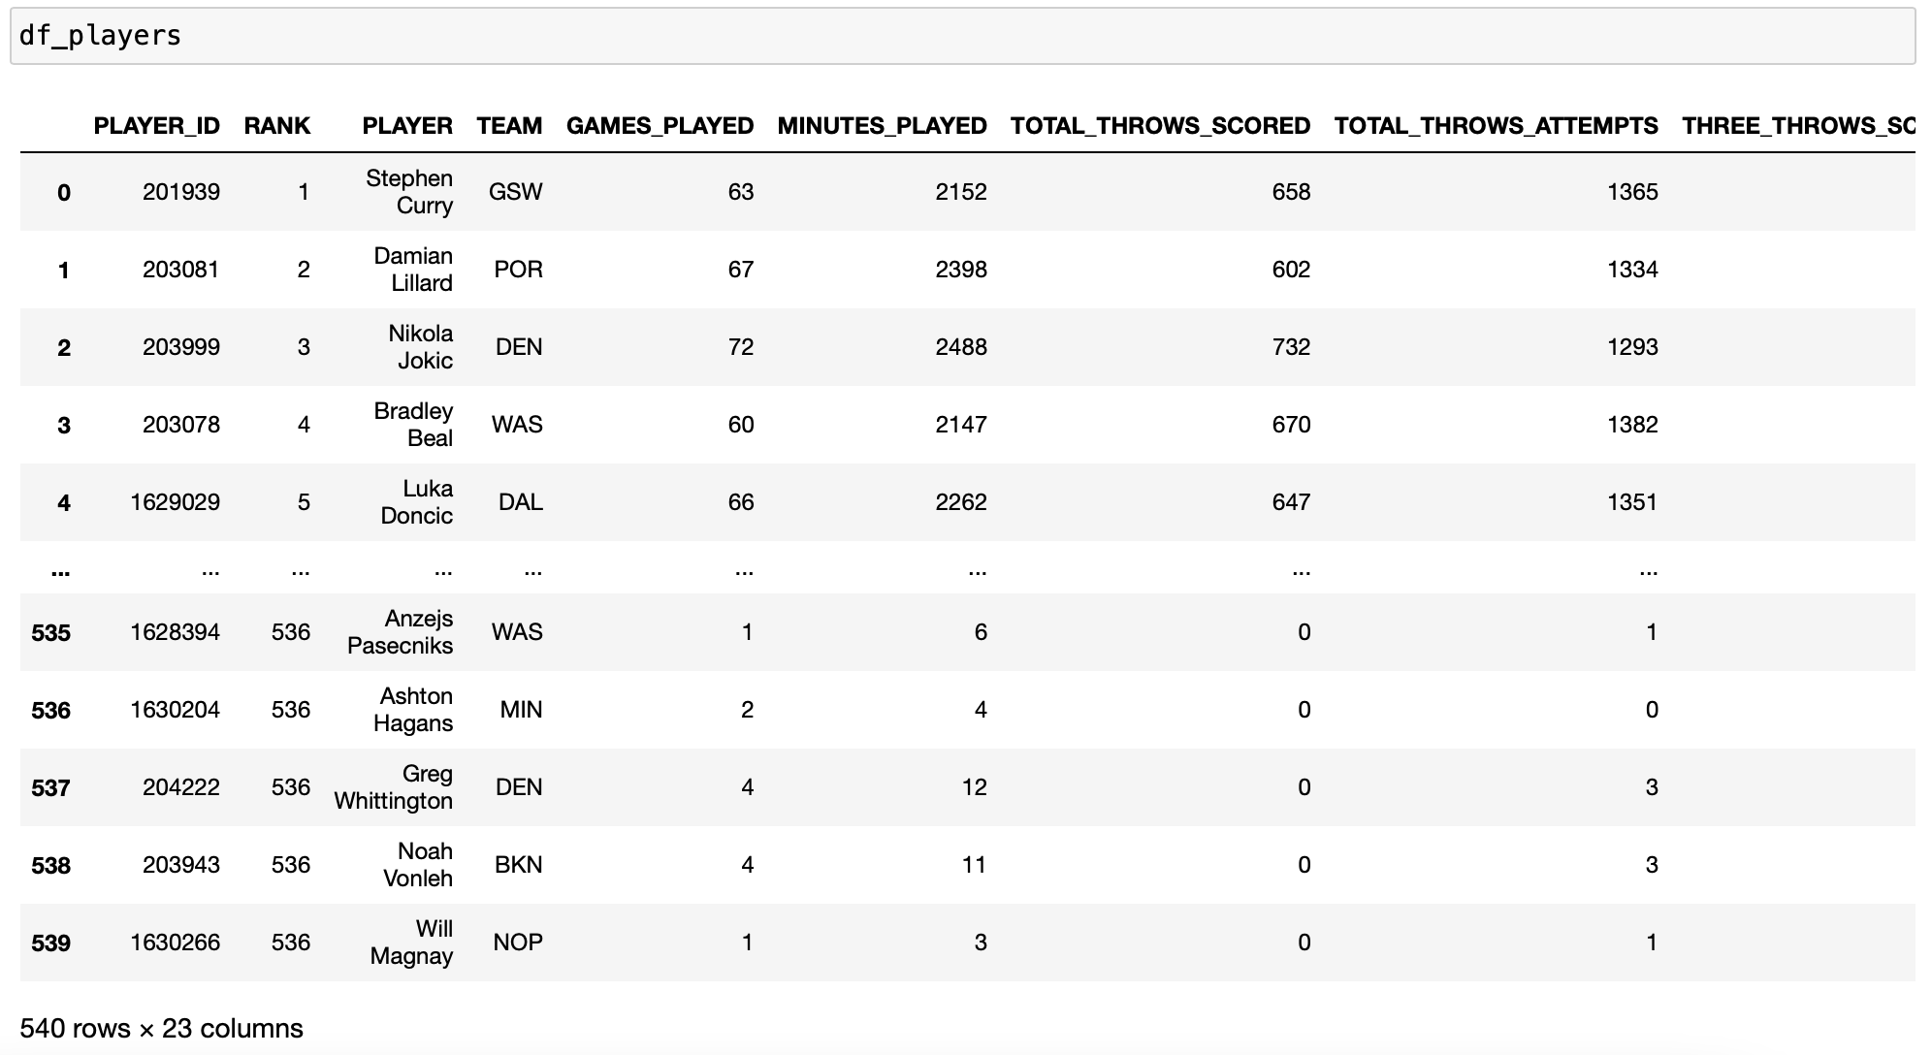
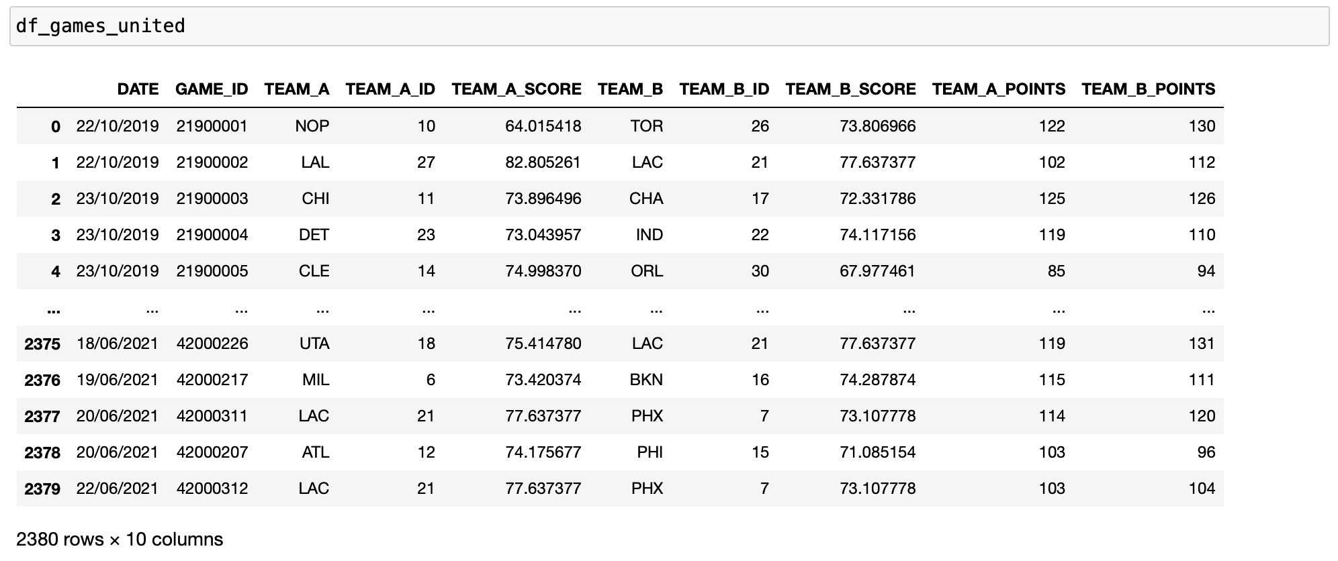
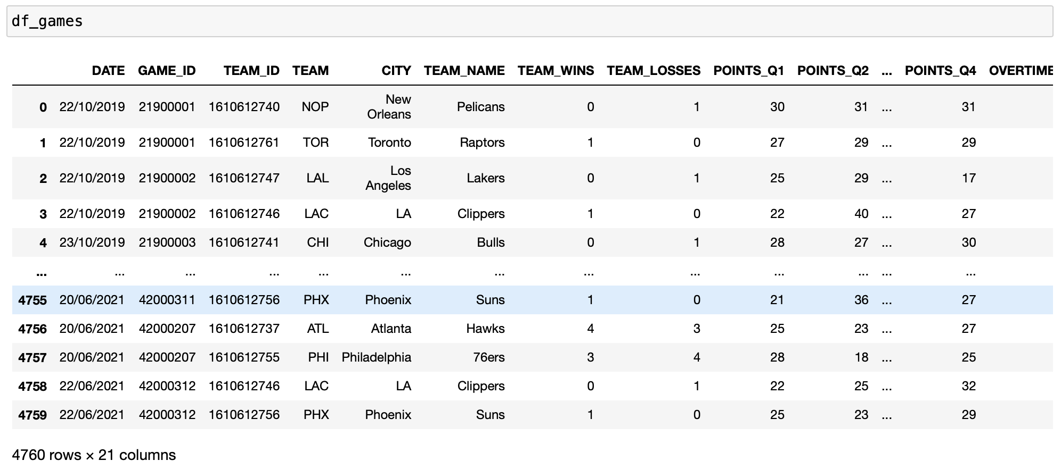

Slide 8

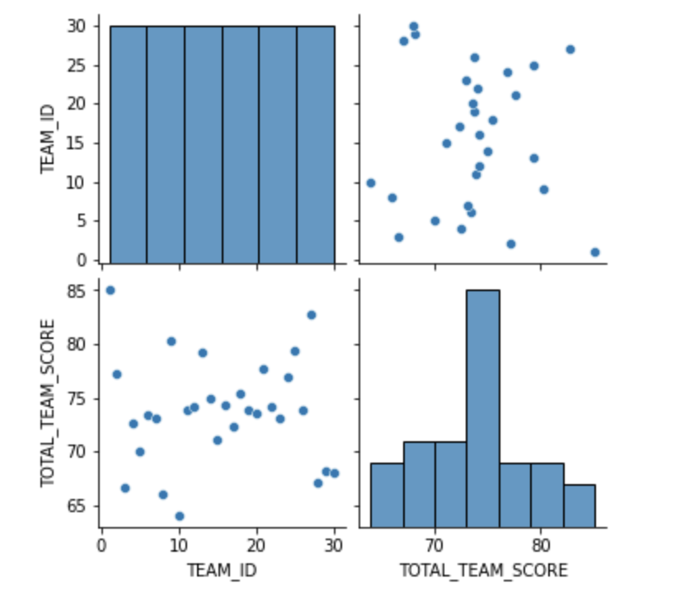
Visualization - EDA
It is hard to conclude anything from the pair plot

Slide 9
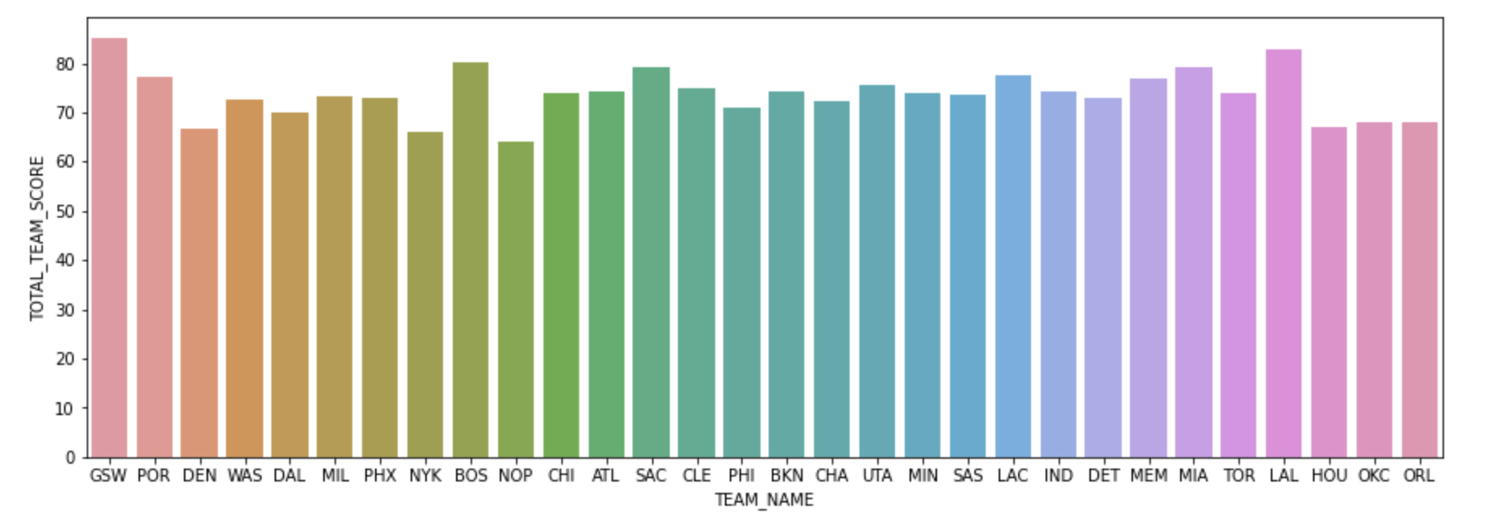
EDA
Team Name & Total Team Score that we calculate.
we can see the team with the highest score, and the ratio between the groups
highest
lowest

Slide 10
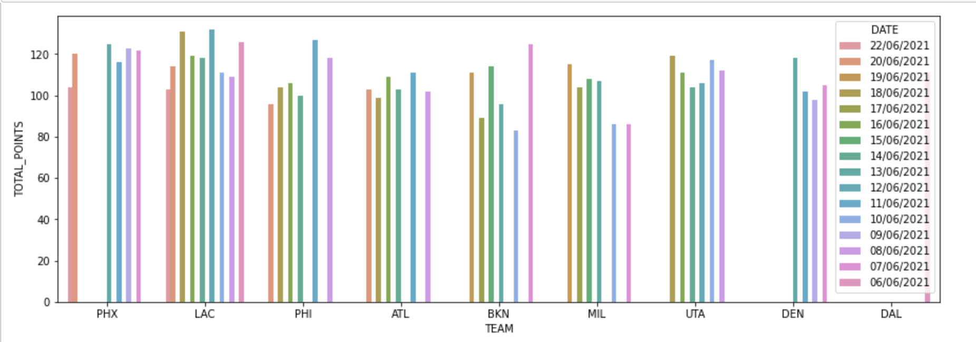
EDA
Team & Total Point in the last games
We can see the score of each team in recent games in relation to the other games.

Slide 11
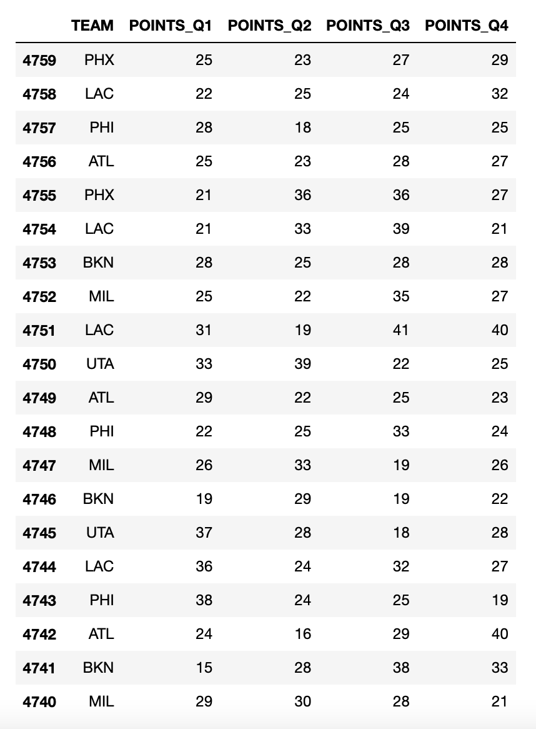
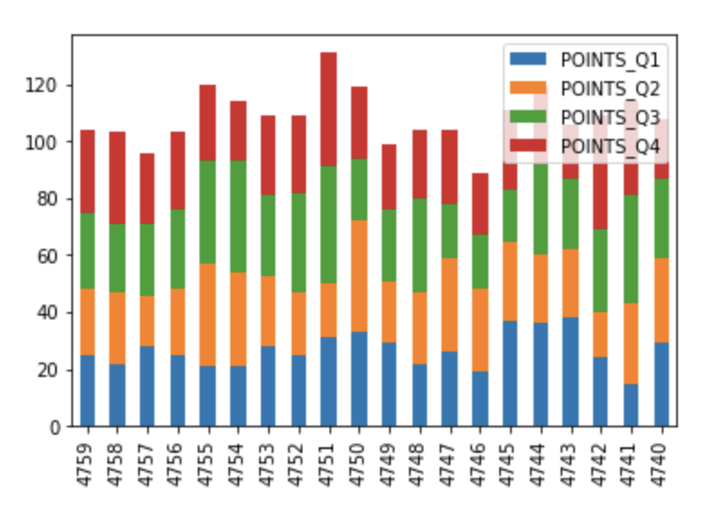
EDA
We created a new data frame - [['TEAM', 'POINTS_Q1', 'POINTS_Q2', 'POINTS_Q3', 'POINTS_Q4’]
Distribution of the score in each quarter in the last 20 games.

Slide 12
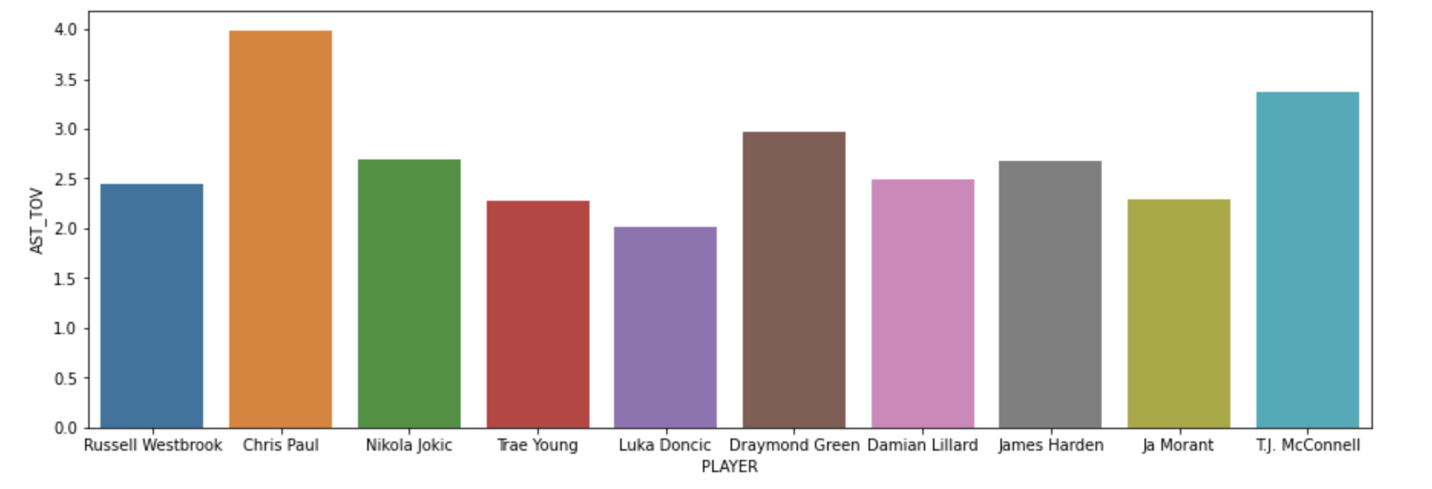
EDA
Player & AST_TOV that we calculate.
The players with the most assists - what is the ratio of lost assists.

Slide 13
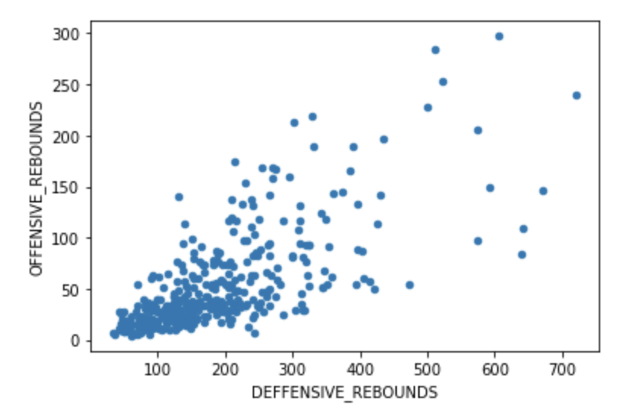
EDA
Offensive Rebounds & Defensive Rebounds & Players
Rebound distribution of all players in the league

Slide 14

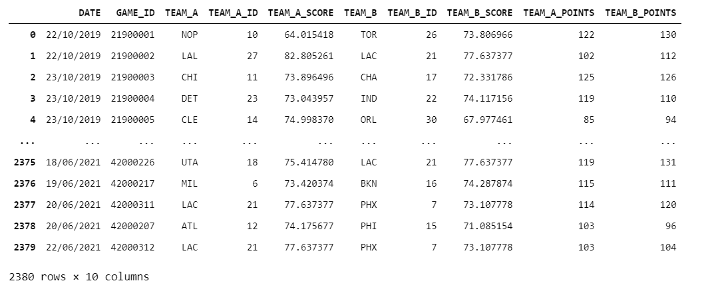
Machine Learning
After the Data Handling stage, we created this data frame:

Slide 15
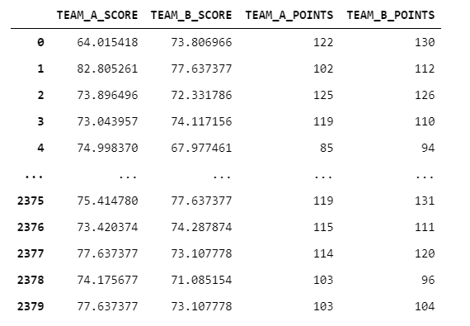
Machine Learning
In this stage we will try to learn and predict the final result of given game.
The model that we chose was Liner Regression.
Parameter to learn about
(X)
Parameter to Predict
(y)

Slide 16
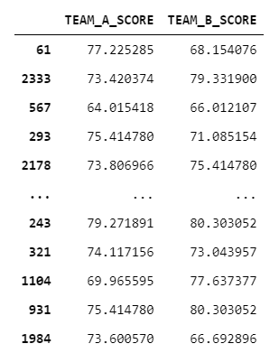
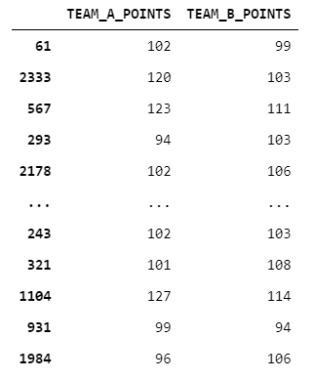
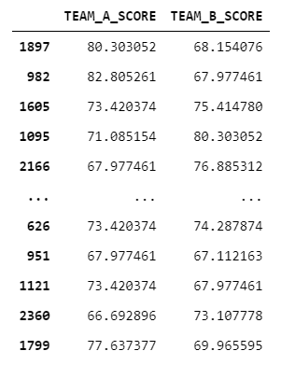
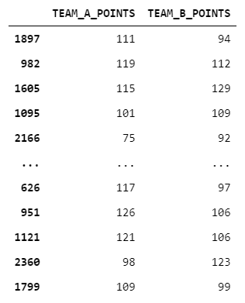
Machine Learning
Splitting the Data to Train and Test:
X_train
y_train
X_test
y_test

Slide 17
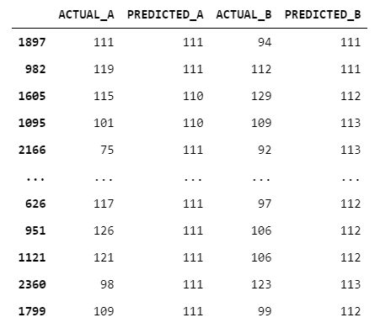
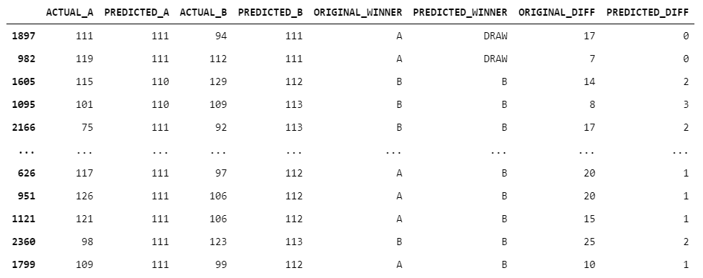
Conclution
After the Learning and Prediction stages, we organized the data and calculated relevant parameters like winning team and points difference.

Slide 18
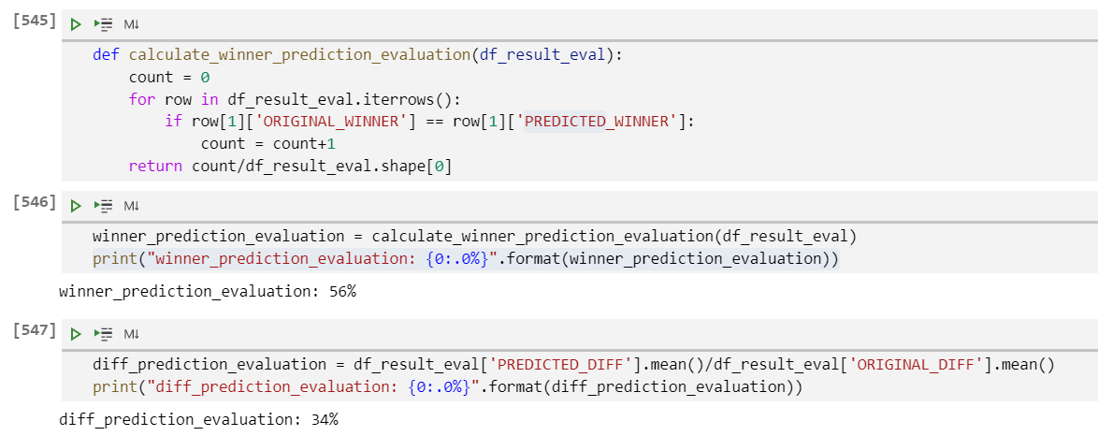
Conclution
With the parameters calculated earlier we evaluated the prediction model:

Slide 19

Thank You

